Slide 1
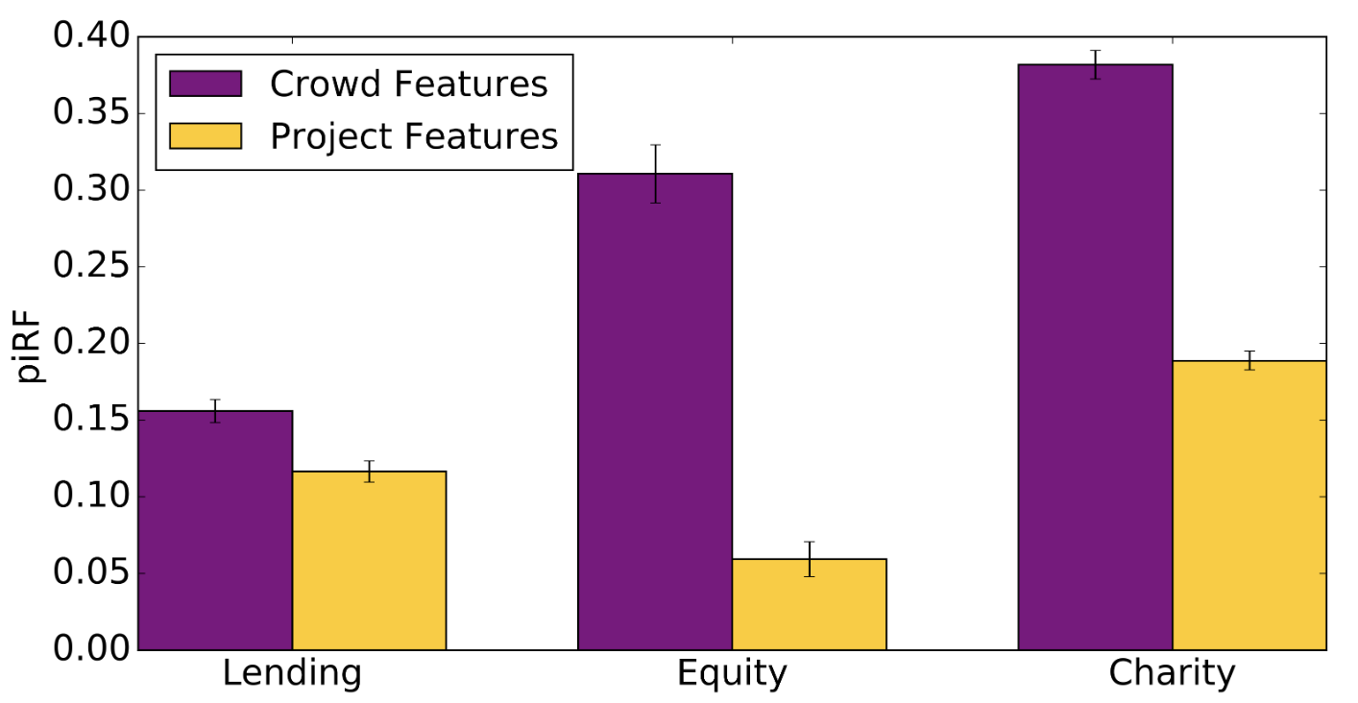
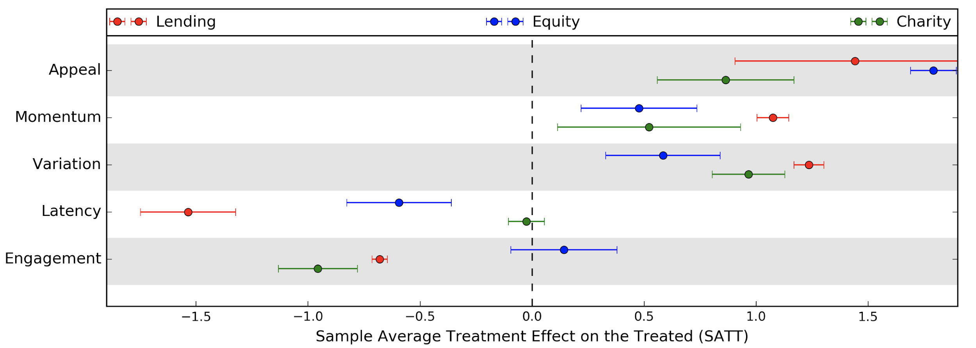



Developed a set of universal features that describe crowd behaviour in online fundraising: (1) Appeal, (2) Momentum, (3) Variation, (4) Engagement, (5) Latency
Systematically tested the importance of the crowd features
Uniform crowd behavior on heterogeneous crowdfunding platforms, hence universal
Crowd features are significantly correlated with fundraising success
Crowd features predict fundraising success better than project features
Crowd features have significant quasi-causal effects on fundraising success
This work is supported by the NSF Grant, Award IIS-1755873.

